Slide 1
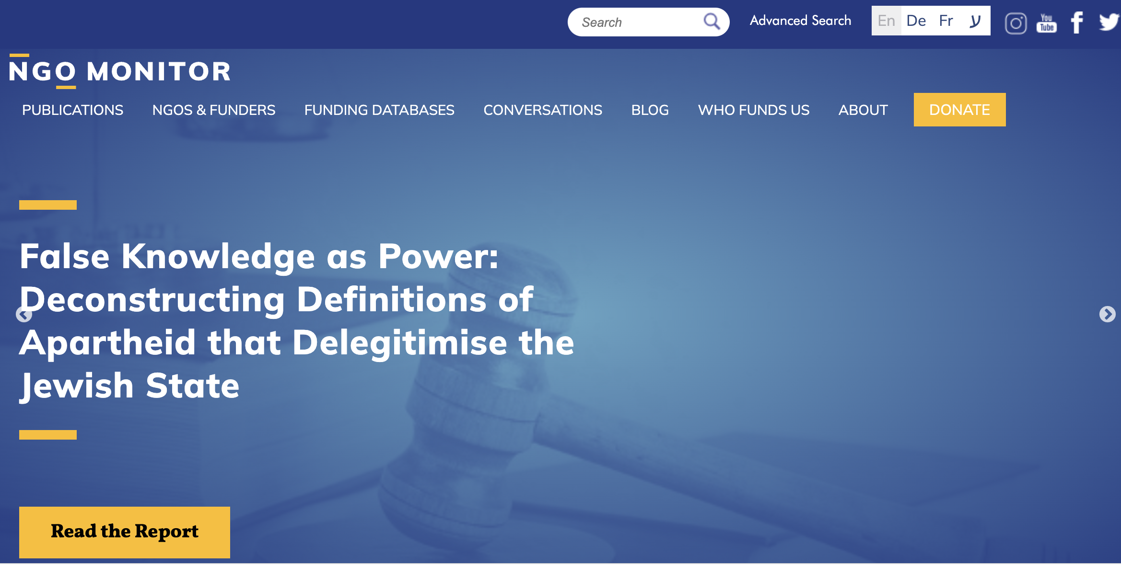
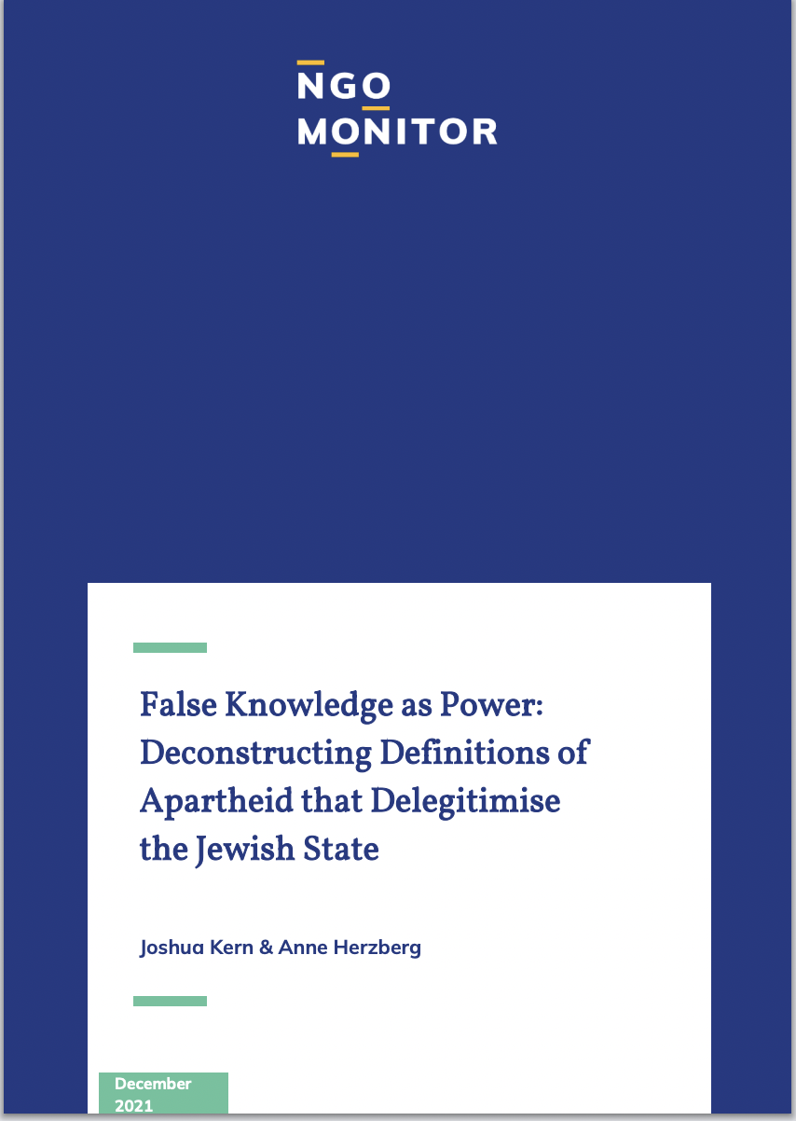
https://www.ngo-monitor.org/reports/apartheid-report/

Slide 3
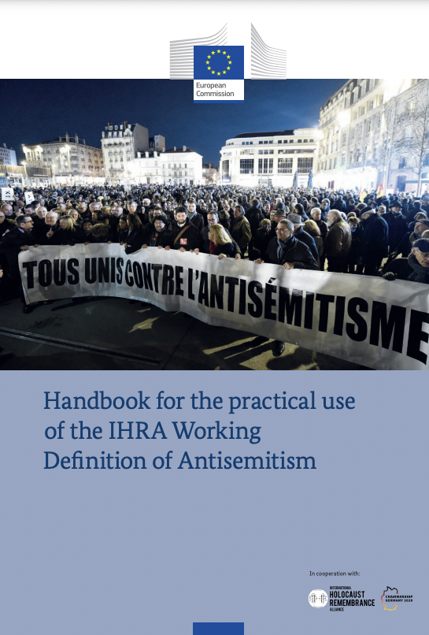
”Denying the Jewish people the right to self-determination and a national homeland is antisemitic because it denies the religious and historic ties of Jews to the land of Israel. It evades the fact that the State of Israel was founded in 1948 based on Resolution 181 (II) of the United Nations General Assembly. Moreover, asserting that a country is a racist endeavour, by portraying ambivalent aspects of modern statehood in a demonizing manner exclusive to the State of Israel, is an attempt to undermine the international legitimacy of a country.”

Slide 4
Fayez Sayegh, Zionist Colonialism in Palestine (1965)
The Zionist settler state remains an alien body in the region. Not only its vital and continuing association with European imperialism, and its introduction into Palestine of the practices of Western colonialism but also its chosen pattern of racial exclusiveness and self-segregation renders it an alien society in the Middle East.
The Zionist settler state has learned all the lessons which the various discriminatory regimes of white settler states in Asia and Africa can teach it. And it has proved itself in this endeavour an ardent and apt pupil, not incapable of surpassing its teachers… Not even in South Africa or Rhodesia has European race-supremacism expressed itself in so passionate a zeal… as it has in Palestine under the compulsion of Zionist doctrines.

Slide 5
March 1968 Security Council Debate
Morocco:
I think that, like a good banker, [Israeli UN Delegate] feels that the credit established by Hitler for the history of Israel has not yet been exhausted. That notion has been made use of, but its historical and moral falsity has been proved. While he told us of the Hitler regime, he neglected to speak to us of the activities of world Zionism well before the turn of the century, of the international deals at the time of the Balfour Declaration, or of the groups which had already been sent to Palestine before the Second World War to establish the Jewish homeland, which cannot be considered as compensation for the concentration camps of which the Jews, as citizens of the occupied countries which suffered under Hitler's racism, were the victims at that time.
Algeria:
With regard to the declaration of President Boumedienne, I wish to say that Algeria is in fact bent on the destruction of all such regimes, be it the apartheid regime or the Zionist regime, both of which are inspired by the same philosophy.

Slide 6
Draft 2001 Durban Declaration
20. Affirm that a foreign occupation founded on settlements, its laws based on racial discrimination with the aim of continuing domination of the occupied territory, as well as its practices, which consist of reinforcing a total military blockade, isolating towns, cities and villages under occupation from each other, totally contradict the purposes and principles of the Charter of the United Nations and constitute a serious violation of international human rights and humanitarian law, a new kind of apartheid, a crime against humanity, a form of genocide and a serious threat to international peace and security;
67. [We are convinced that combating anti-Semitism, Islamophobia and [Zionist practices against Semitism] is integral and intrinsic to opposing all forms of racism and stress the necessity for effective measures to address the issue of anti-Semitism, Islamophobia and [Zionist practices against Semitism] today in order to counter all manifestations of these phenomena;]…
68. [We recognize with deep concern the increase in anti-Semitism and hostile acts against Jews in various parts of the world, as well as the emergence of racial and violent movements based on racism and discriminatory ideas concerning the Jewish community.] [The World Conference recognizes with deep concern the increase of racist practices of Zionism and anti-Semitism in various parts of the world, as well as the emergence of racial and violent movements based on racism and discriminatory ideas, in particular the Zionist movement, which is based on racial superiority;]…

Slide 7
NGO Forum Declaration and Program of Action
162. We declare Israel as a racist, apartheid state in which Israels brand of apartheid as a crime against humanity has been characterized by separation and segregation, dispossession, restricted land access, denationalization, ¨bantustanization¨ and inhumane acts.
419. Also call for the reinstitution of UN resolution 3379 determining the practices of Zionism as racist practices which propagate the racial domination . . . and through the application of discriminatory laws of return and citizenship, to obliterate their national identity and to maintain the exclusive nature of the State of Israel as a Jewish state to the exclusion of all other groups.
424. … the launch of an international anti Israeli Apartheid movement as implemented against South African Apartheid through a global solidarity campaign network of international civil society, UN bodies and agencies, business communities and to end the conspiracy of silence among states, particularly the European Union and the United States.
425. … the international community to impose a policy of complete and total isolation of Israel as an apartheid state as in the case of South Africa which means the imposition of mandatory and comprehensive sanctions and embargoes, the full cessation of all links (diplomatic, economic, social, aid, military cooperation and training) between all states and Israel.

Slide 8
Noura Erakat, EJIL Talk! Blog, July 2021
“Zionist belief that Jews constitute a race and a singular people, irrespective of religious piety or identification, produces ‘three corollaries: racial self-segregation, racial exclusiveness, and racial supremacy.’

