Slide 1
Tracing the Trope of Redemptive Antisemitism by David Patterson Hillel A. Feinberg Distinguished Professor Ackerman Center for Holocaust Studies University of Texas at Dallas Senior Research Fellow Institute for the Study of Global Antisemitism and Policy

Slide 2
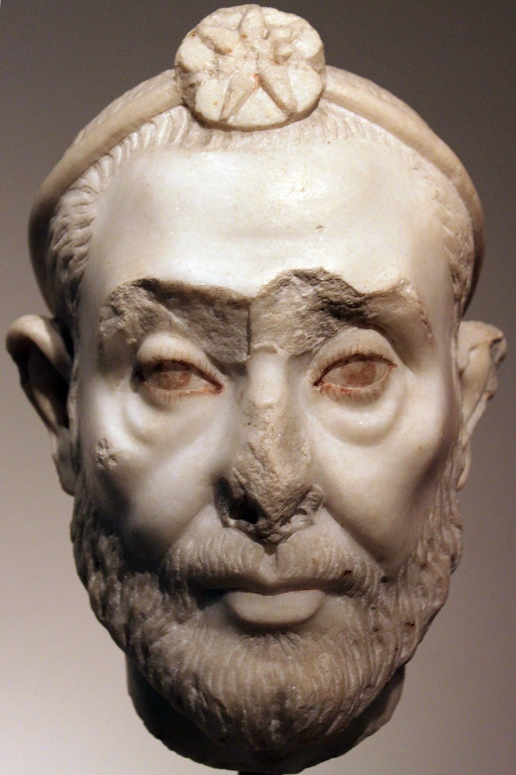
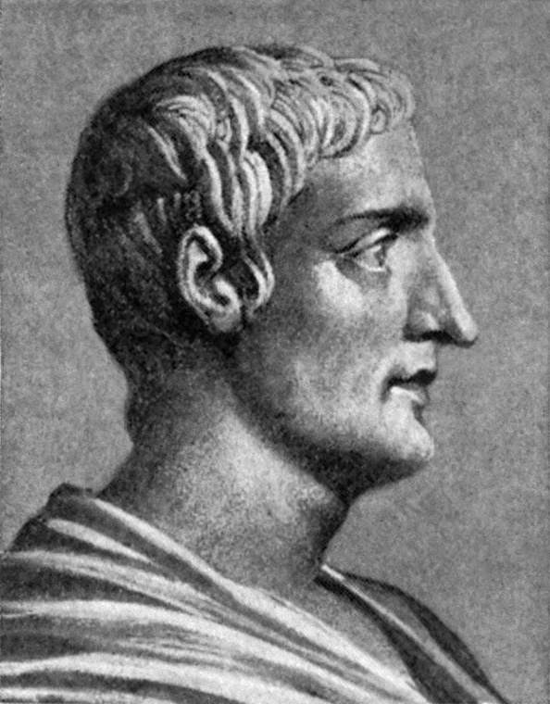
Early Cultural Expressions of Antisemitism Democritus Manetho Tacitus (460- 370 BCE) (3rd Cent BCE) (56 – 120 CE)

Slide 3
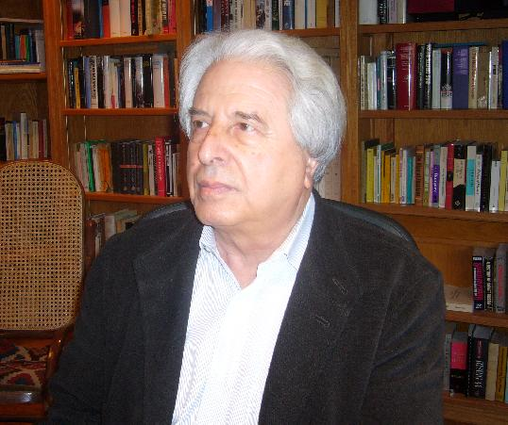
Saul Friedländer (b. 1932), The Years of Persecution, Years of Extermination (2010)
“In redemptive anti-Semitism
the struggle against the Jews
is the dominant aspect of a
worldview in which other racist
themes are but secondary
appendages… . Redemption
would come as liberation from
the Jews - as their expulsion,
possibly their annihilation.”

Slide 4
I would add:
Redemptive antisemitism arises with the human usurpation of the divine throne of judgment in the determination of the damned and the redeemed.

Slide 5
Redeemed from what? The evil Eternal Jew and the contagion of Judaism.

Slide 6
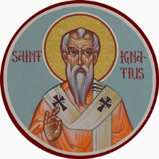
St. Ignatius of Antioch (ca. 35 – 108): The Jew Delegitimized
\
“Do not observe Jewish commandments,” disconnecting from the mitzvot, as found in the Torah.

Slide 7
The Promise of Redemption: The Stake in the Elimination of the Jew
“He who believes in the Son has everlasting life; and he who does not believe in the Son shall not see life, but the wrath of God abides on him.”
John 3:36

Slide 8
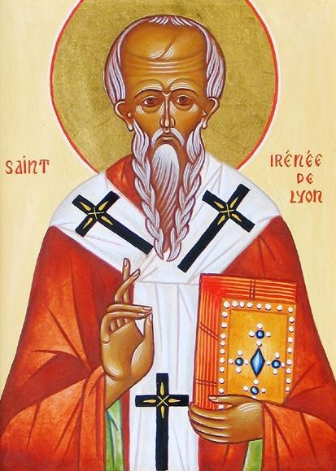
St. Irenaeus (130 – 202) The New Dispensation, the Key to Redemption
“When the new comes, the old is done away with,” superseded and illegitimate.

Slide 9
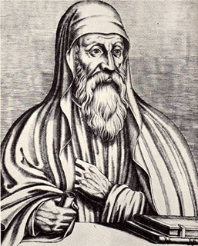
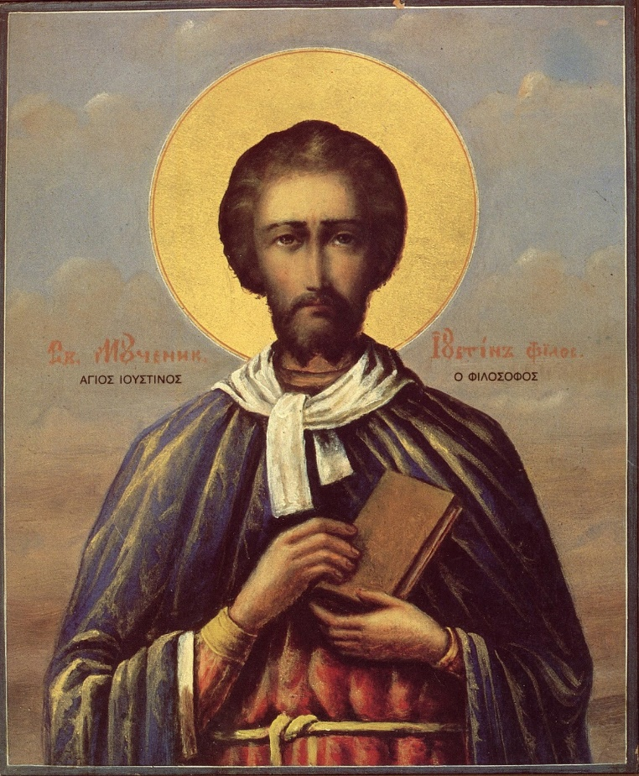
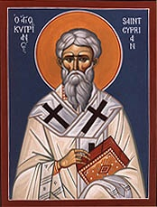
Teaching of Contempt: Jews as Deicides (150 -258) Tertullian Justin Martyr Origen Cyprian

Slide 10
Joel Carmichael: The Satanizing of the Jews “What would otherwise have been mere exoticism, a cluster of normal dissimilarities between different groups, was escalated by the Jewish role as a Counter-Incarnation to a level of lofty horror that, in the very process of ‘sparing’ the Jews, heightened their demonically powerful character.”

Slide 11
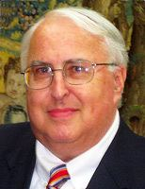
Steven Katz: The Holocaust in Historical COntext
Once the Jews become a
theological category, they
become “a mythic creature…
Jews, a Jew, can be God
incarnate; they can be the
Devil incarnate; but they can
never again be merely human
beings.”

Slide 12
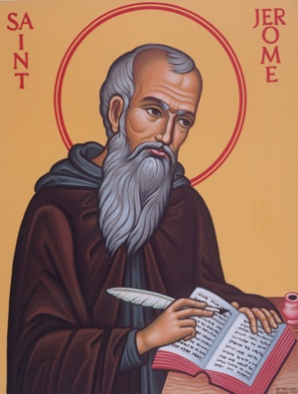
St. Jerome (347 – 420)
Demonization: “Whoever observes ceremonies of the Jews… has fallen into the pit of the devil.”

Slide 13
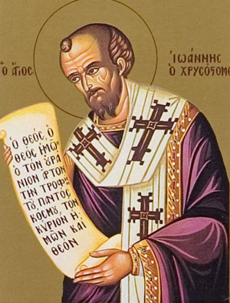
St. John Chrysostom, the “Golden-Mouthed” (349 – 407)
Demonization, naming the evil:
“What is in the synagogue of
the Jews who fight against God?
It is the devil, who leads them
in their revels.”

Slide 14
Ephraim of Syria (306 – 372) Holy Hatred of the Jew Added to the Liturgy

Slide 15
Eusebius of Caesaria (d. 444): Hatred of the Jews is holy and pleasing to God.

Slide 16
Athanasius I of Constantinople (1230 – 1310): Redemptive hatred: “It is the duty of Christians to hate the deicidal Jews.”

Slide 17
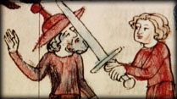
Rhineland Massacres of 1096
“Anyone who kills a Jew will have his sins forgiven” and thus attain redemption.

Slide 18
Pope Innocent III (1161 – 1216) Fourth Lateran Council (1215) “The blood of Jesus calls out…” to be redeemed by blood, by bleeding humanity of its impure blood..

Slide 19
Jesus the Redeemer Brought before Caiaphas, ca. 1275 The Jews Delegitimized, Dehumanized, Demonized

Slide 20
Desecration of the Host, 1243 The Murder of the Redeemer Re-enacted, Ritualized, Satanized

Slide 21
Burning the Talmud, Paris, 1242, Pope Gregory IX “When you begin by burning books, you end by burning people.” Heinrich Heine, 1834

Slide 22
Burning People: Rindfleisch Massacres of Jews, 1298 – 1299: Not Punishment but Purification Necessary for Redemption

Slide 23
Burning Jews during the Black Death, 1349: Jews are the carriers of the contagion of Judaism, which threatens the life of the soul.

Slide 24
Threat of Damnation: The Devil and the Jews, 15th Century

Slide 25
Tomás de Torquemada (1420 – 1498) Spanish Inquisition (1478 – 1834) Redemption lies in correct belief. Heresy is false belief. The heresy of Judaism threatens redemption.

Slide 26
Auto Da Fe: Purification and Salvation

Slide 27
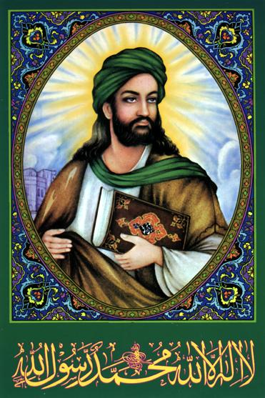
Muhammad (570 – 632)
“This is the book [of redemption]”
(Quran 2:2).
“Allah has cast aside [the Jews],
on whom His wrath has fallen and
of whom He has made some as
apes and swine... .” (Quran 5:60)
Jews referred to as “Satans” who
undermine true belief.
(4:55, 4:60, 58:14-19, 98:6)

Slide 28
The Promise of Redemption
“Those who believe and do right will have gardens of Paradise as a gift.”
Quran 18:107

Slide 29
Slaughter of Banu Qurayzah, Expulsion of Badu Nadir and Banu Qainuqah (624 – 628)

Slide 30
Abbasid Caliph al-Mutawakkil (822 – 861) Jews and Christians must attach images of devils to their homes: they threaten the salvation of the Muslims.

Slide 31
Granada Massacre of 1066 Purging the Impurity

Slide 32
Ibn Tumart of Morocco (1080 – 1130) Purification and redemption: “Come, and let us cut them off from being a nation, that the name of Israel may be no more in remembrance.”

Slide 33
Abdul Ala Maududi (1903 – 1979) “Islam wants the whole earth and does not content itself with only a part thereof. It wants and requires the entire inhabited world,” not to rule but to redeem. The Jews are “the devil” who threatens this salvation of all humanity.

Slide 34
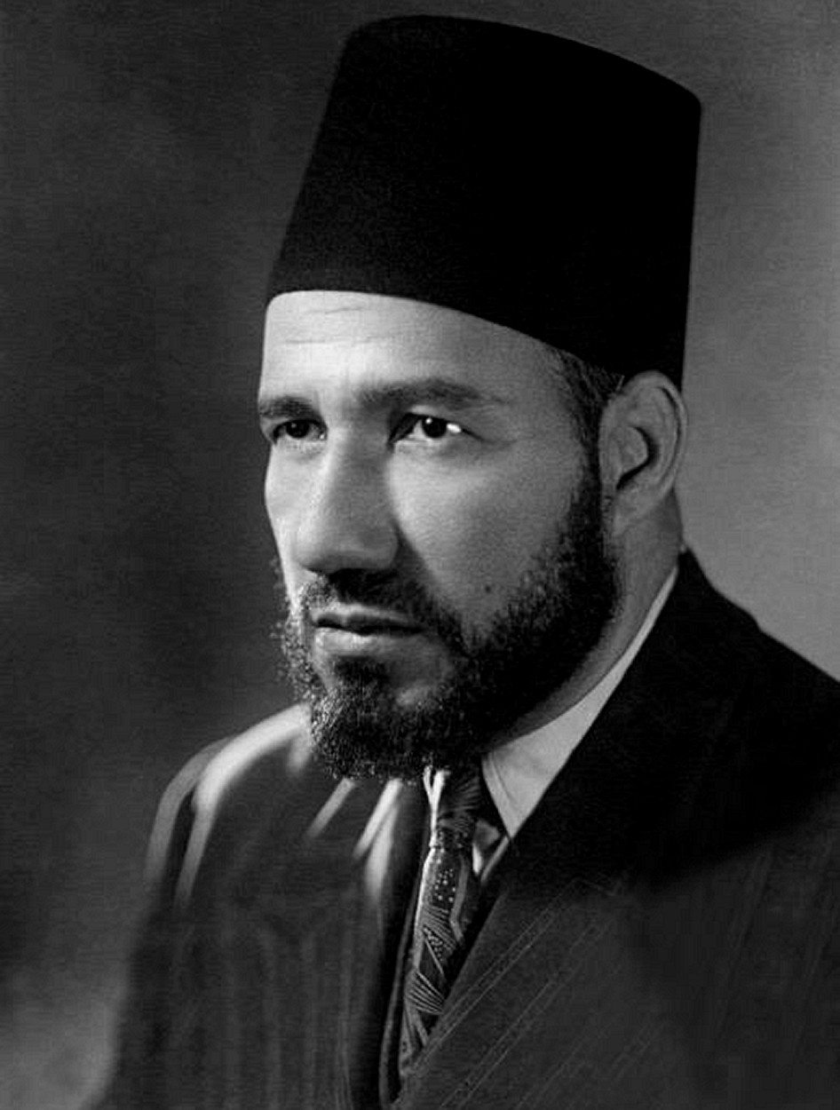
Hassan al-Banna (1906 – 1949) Muslim Brotherhood, 1928: Muslims have always fought a war against the Jews, the source of all evil. “The mission of the Muslim Brotherhood is pure and unsullied, unblemished by any stain” from the Jews.

Slide 35
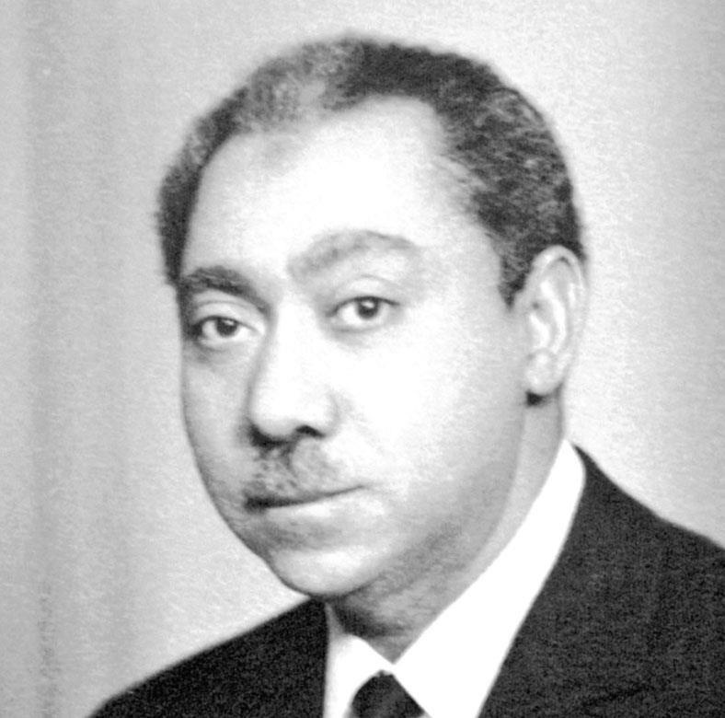
Sayyid Qutb (1906 – 1966)
The Jews are the hizb
al-shaytan, the party of Satan.
Only Islam can save humanity
from the evil of the Jews. It is a
religious duty to exterminate
them, and religious duty is
redemptive.

Slide 36
Abdel Halim Mahmoud, Grand Imam of Al-Azhar University (1910 – 1978) Allah commands Muslims to fight the friends of Satan, and chief among his friends are the Jews, who, like Satan, threaten the soul of the believer.

Slide 37
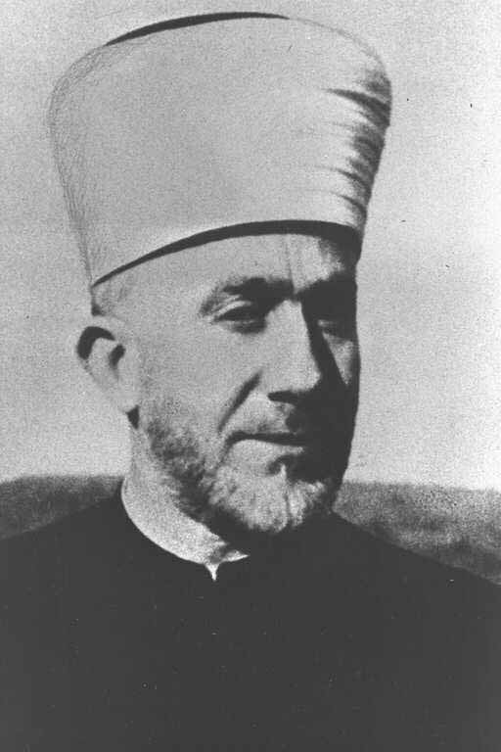
Nazi War Criminal Haj Amin al-Husseini (1893 – 1974)
“Slaughter Jews wherever you find
them. Their spilled blood pleases
Allah… He who kills a Jew is assured
a place in the next world.”

Slide 38
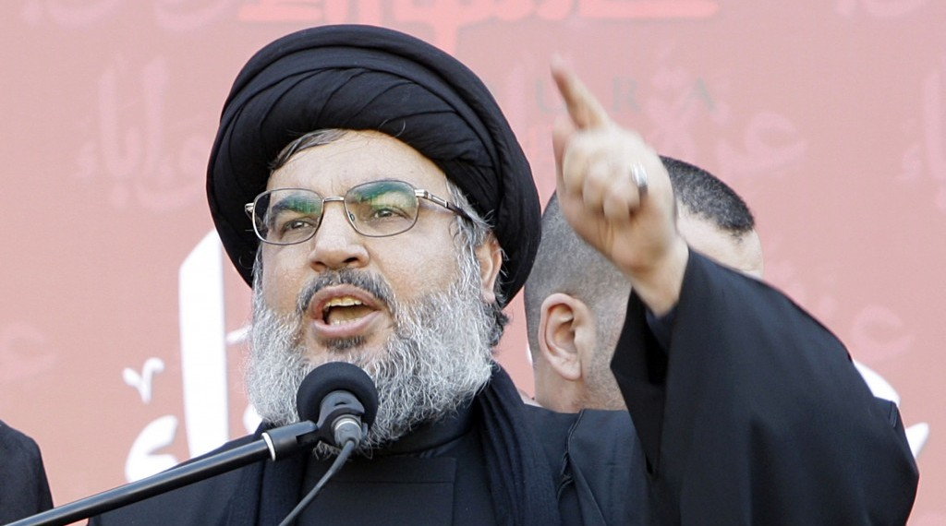
Hezbollah LeaderHassan Nasrallah (b. 1960) The Jews are “a cancerous growth and harmful microbe, this entity without borders,” and Hezbollah is the “clearinghouse for all humanity.”

Slide 39
Rothschild, C. Leandre (1898) Theological treat becomes a cosmic threat, a metaphysical threat.

Slide 40
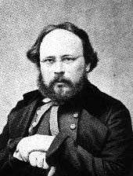
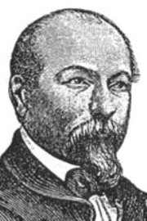
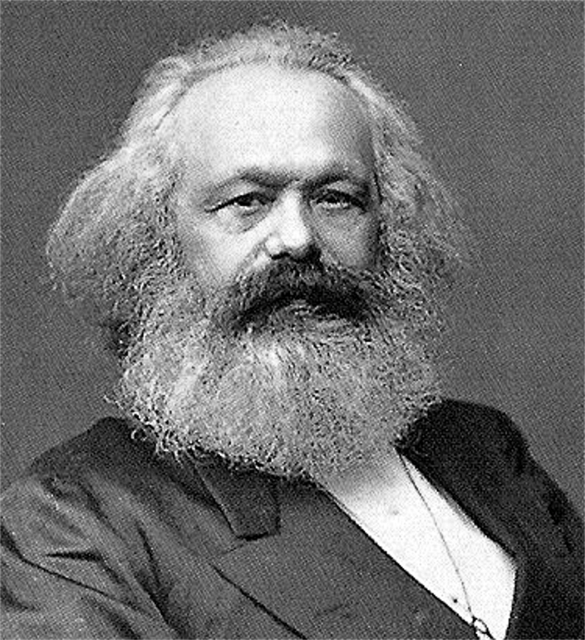
Ideological Redemption: Fourier Toussenel Proudhon Marx

Slide 41
Charles Fourier (1772 – 1837): There has never been a “nation more despicable than the Hebrews.” Alphonse Toussenel (1803 – 1885): “I understand the persecution that the Romans, the Christians and the Moslems made the Jews suffer…, and our contempt is a legitimate retribution.” Pierre-Joseph Proudhon (1809 – 1865): “It is not for nothing that the Christians call them deicides. The Jew is the enemy of the human race.” Karl Marx (1818 – 1883): “The emancipation of the Jews is the emancipation of mankind from Judaism.”

Slide 42
Joel Carmichael on ideological redemption: The Satanizing of the Jews “From the very beginning of the Socialist movement in the wake of the French Revolution, it was usual to take over the ancient stereotype of the Jews, rooted in Church doctrine, and dress it up in a more contemporary form as a way of describing the enemy” of the utopian, redemptive dream.

Slide 43
The Jew: An Invisible Cosmic Evil

Slide 44
Protocols of the Elders of Zion (1903) P. I. Rachkovsky S. A. Nilus

Slide 45
Invisible Wirepullers

Slide 46
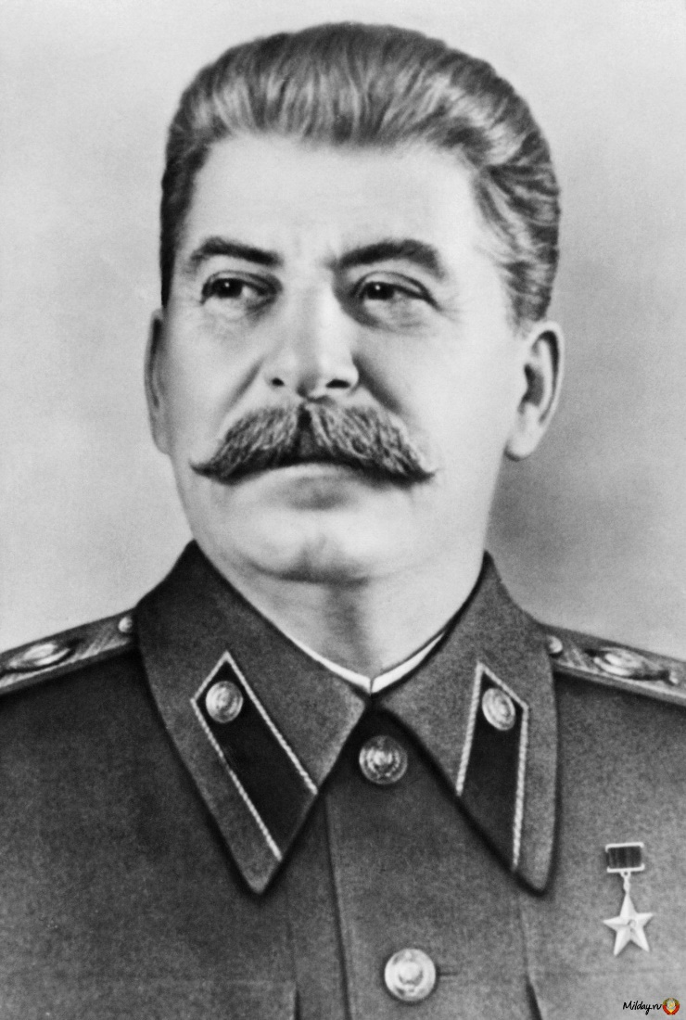
Ideological Promise of Redemption: Protocols Thinking Hitler Stalin

Slide 47
Enter Anti-Zionism

Slide 48
Yakov Malik, Soviet UN Ambassador, 1973 “Zionism is racism.” Resolution 3379 (1975)

Slide 49
Omar Barghouti, Founder of BDS: Israeli soldiers hunt children. Jews control the US. (UCR, Jan 2014)

Slide 50
Israeli Apartheid Week: If it is evil, it stems from the Jewish state.

Slide 51
Franz Rosenzweig (1886 – 1929) “The existence of the Jew constantly subjects Christianity to the idea that it is not attaining the goal, the truth, that it ever remains—on the way. That is the profoundest reason for the Christian hatred of the Jew.”

