Slide 1
Do Human Rights Still Apply to the Jewish People?
On Weakening the Human Rights Law Protection against Antisemitism
Dr Aleksandra Gliszczyńska-Grabias
Institute of Law Studies, Polish Academy of Sciences

Slide 2
Antisemitism: perhaps the most ancient and persistent manifestation of human rights violations
The fight against antisemitism has given wings to the international human rights movement in the 20th century
Historically, however, both in the "ages of faith" and in the "ages of reason" law was used not for protection, but for social and cultural isolation, religious or racial stigma, and, in the most drastic cases, for physical extermination of Jews.
19th/20th century:
No civil rights for Jews in Switzerland
No access to public service for Jews in the UK
Pogroms in Russia and Central and Eastern Europe
„Ghetto benches” in Poland
Nuremberg Laws of 1935

Slide 3
The name “United Nations” was coined to describe the alliance fighting to end that barbarous regime, and our Organization came into being when the world had just learnt the full horror of the concentration and extermination camps. It is therefore rightly said that the United Nations emerged from the ashes of the Holocaust. And a human rights agenda that fails to address anti-Semitism denies its own history.
Kofi Annan, UN Secretary General, 2004
Your presence reminds us about our raison d'être, about our roots and hopes. Indeed, the very concept of the Council of Europe would not have arisen without a cataclysm, what was World War II, without Shoah and racist lessons of the totalitarian wave that swept across Europe.
Hans-Christian Krüger, former Council of Europe Deputy Secretary General, 2000

Slide 4
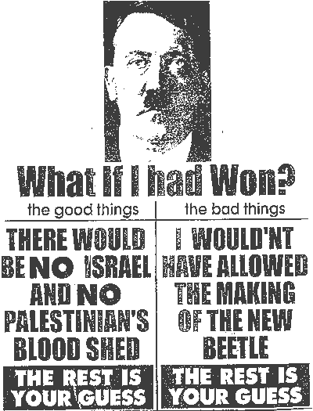
http://www.focusonisrael.org/2008/02/20/durban-2001-per-rinfrescarci-la-memoria/

Slide 5
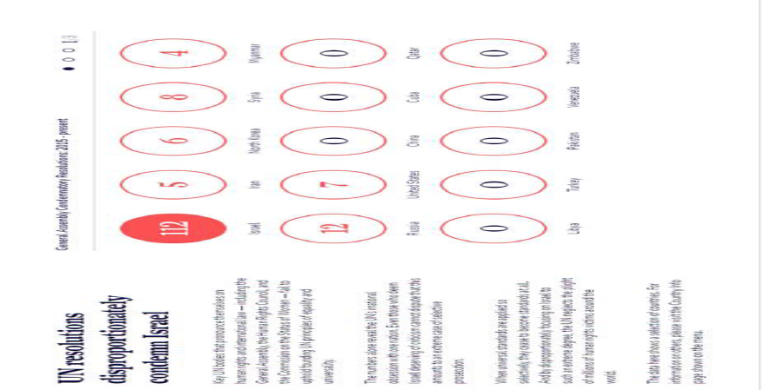
UN shameful statistics: UN Watch

Slide 6
Attempts to deprive antisemitism of its true meaning
At the 5th session of the UN Human Rights Council, when delegates discussed the report of the Special Rapporteur on racism, a representative of Algeria argued that antisemitism should not be related to Jews only but to all Arabs.
UN Human Rights Commission: representatives of Lebanon, Egypt and Syria and the Palestinian observer spoke many times of true antisemites, i.e. Jews, about hijacking of the term “antisemitism” by Jews, about Arab victims of antisemitism and about the irrelevance of the accusation of Egypt of anti-Semitism since the Egyptians themselves are Semites to a much larger degree than Jews..

Slide 7
Dr. Ahmed Shaheed’s, the UN Special Rapporteur on Freedom of Religion or Belief, 2019 historic report on antisemitism
states that some antisemitism stems from religious narratives (“collective guilt for the murder of Jesus”) and expressions of contempt for the Jewish religion (including “the false allegation of ritual murders”);
rejects use of negative stereotypes like those in the “discredited forgery” The Protocols of the Elders of Zion, which “underpin modern conspiracy theories”;
confronts and rejects politicization of antisemitism: “individuals claiming to hold anti-racist and anti-imperialist views employ antisemitic narratives or tropes while expressing anger at policies or practices of Israel”;
“in some cases, individuals expressing such views have engaged in Holocaust denial; in others, they have conflated Zionism, the self-determination movement of the Jewish people, with racism”; „it is never acceptable to render Jews as proxies for the Government of Israel.”

Slide 8
BDS as a systemic violation of human rights law
Coordinated, organized actions of BDS against Israel and Israeli products, academics, students or institutions, which receive great media coverage and are being represented as „resistance movement” against drastic violations of human rights by Israel, lead to multiple breaches of human rights and freedoms of persons not only associated with or connected to the state of Israel but all persons with Jewish background, in the sense of their national, ethnic or religious origins.
As a result of BDS, these persons experience discrimination, persecution, exclusion and intimidation. Their rights to personal dignity, safety, and often to freedom of expression, assembly and association are violated. Frequently, prohibitions on hate speech are breached, and often boycott actions have the character of incitement to hatred, based on ethnic or national origins.

Slide 9
European Court of Human Rights on BDS: 2009
In 2002 Jean-Claude Willem - the mayor of the municipality of Seclin, in France, during a session of the town council and in the presence of journalists, announced that the municipal catering services will boycott Israeli products, in order to protest against what he considered anti-Palestinian policies of the Israeli Government.
Representatives of the Jewish community filed a complaint with the public prosecutor, who charged Willem with inciting discrimination on national, racial, and religious grounds. Willem was first acquitted but sentenced on appeal and fined 1,000 euros. His appeal against conviction was unsuccessful.
In his complaint lodged to the ECtHR Willem claimed that his call to boycott Israeli products was part of a political debate concerning the Israeli-Palestinian conflict and was a matter of general and public interest. He complained that his conviction had thus constituted a violation of his right to freedom of expression within the meaning of Article 10 of the European Convention.

Slide 10
European Court of Human Rights on BDS
Willem had not been convicted for his political opinions but for inciting the commission of a discriminatory act.
He had not stopped at denouncing the policy of Ariel Sharon’s government, but had gone further and called for a boycott of food products from Israel.
French Court of Cassation had taken into account not only the call for a boycott made at the council meeting but also the message posted on the municipal Internet site, which had aggravated the discriminatory nature of Willem’s position.
In his capacity as mayor Willem was in charge of spending public funds, and thus he should not “advocate spending them along the lines of a discriminatory logic”.
Willem’s intention may have been to protest against the policy of Israel’s Prime Minister, but the reasons given for the boycott were discriminatory and therefore reprehensible.
No violation of Article 10 of the European Convention on Human Rights

Slide 11
European Court of Human Rights on BDS: 2020
The applicants were members of a local collective supporting BDS. They were prosecuted for calling on customers in a hypermarket not to purchase products from Israel, under a subsection of the Law on Freedom of the Press prohibiting incitement to discrimination against a group of persons on account, inter alia, of their origin or belonging to a specific nation.
The applicants were acquitted at first instance but on appeal a suspended fine of one thousand euros was imposed on them, and they were ordered to pay damages to the associations appearing as civil parties.

Slide 12
European Court of Human Rights on BDS: 2020
A boycott is primarily a means of expressing a protest: a call for a boycott, is in principle covered by the protection set out in Article 10.
Incitement to discrimination is a form of incitement to intolerance, which, together with incitement to violence and hatred is not covered by free speech protection.
Nevertheless, incitement to differential treatment is not necessarily the same as incitement to discrimination.
The applicants had not been convicted of making racist or antisemitic remarks or inciting to hatred or violence. Nor had the hypermarket claimed damages before the domestic courts.
The actions and remarks imputed to the applicants had concerned a subject of public interest: compliance with public international law by the State of Israel and the human rights situation in the occupied Palestinian territories.
The actions and remarks in question had fallen within the ambit of political expression. It was in the nature of political speech to be controversial and often virulent.

Slide 13
European Court of Human Rights on BDS:
Willem v. France v. Baldassi and others v. France
In Willem the applicant had been acting in his capacity as mayor and using mayoral powers regardless of the duties of neutrality and discretion. He had made the announcement of boycott without a prior debate or vote in the municipal council, which meant that he could not claim to have encouraged free discussion of a subject of public interest.
In Baldassi applicants were ordinary citizens who were not restricted by the duties and responsibilities arising from a mayoral mandate and whose influence over consumers was not comparable to that of a mayor over his municipal services. The reason why the applicants had issued the calls for a boycott had been to trigger or stimulate debate among supermarket customers.

Slide 14
Searching for answers:
Well-planned, coordinated strategy of capturing public perception of human rights protection in the context of Jews/Palestinians (but also more broadly)
Strong position of anti-Jewish agenda at UN bodies and institutions
Radical left-wing human rights agenda
Populist, right-wing, anti-democratic governments
Lack of effective human rights law enforcement mechanisms and policies
Social media antisemitism – unprecedented forms and scale
Weak response
Searching for solutions:
Public interest strategic litigation, national and international
Bringing back and effectively promoting the true story of human rights protection origins and goals
PR
Finding new allies
Investing in reaserch on antisemitism and methodologies of measuring effectiveness of tools used against it

Slide 15
Thank you for your attention!

